Slide 1
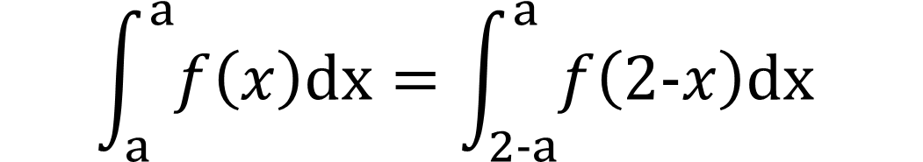

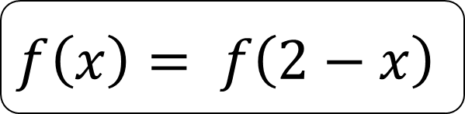
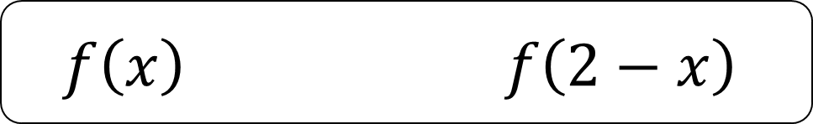
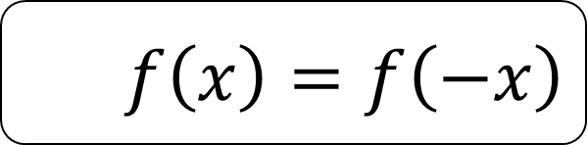
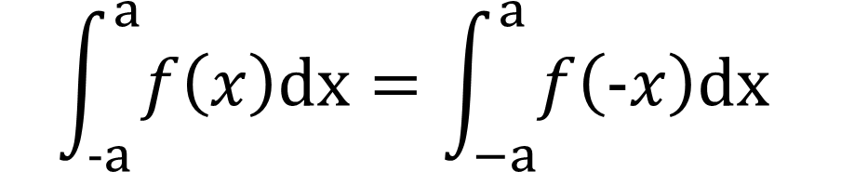

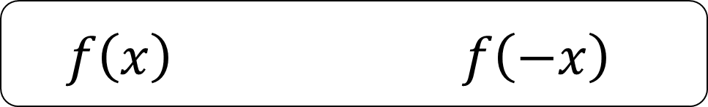

치환적분+적분 대칭성
=t 치환
$$\int_{a}^{b}{f\left(x\right)dx}=\int_{a}^{b}{f\left(a+b−x\right)dx}$$
y축대칭
$$f\left(x\right) f\left(−x\right)$$
$$f\left(x\right)=f\left(−x\right)$$
$$\int_{−a}^{a}{f\left(x\right)dx}=\int_{−a}^{a}{f\left(−x\right)dx}$$
x=1대칭
$$f\left(x\right) f\left(2−x\right)$$
$$f\left(x\right)= f\left(2−x\right)$$
$$\int_{a}^{a}{f\left(x\right)dx}=\int_{2−a}^{a}{f\left(2−x\right)dx}$$
https://www.geogebra.org/classic/tvzgwvbc

Slide 2
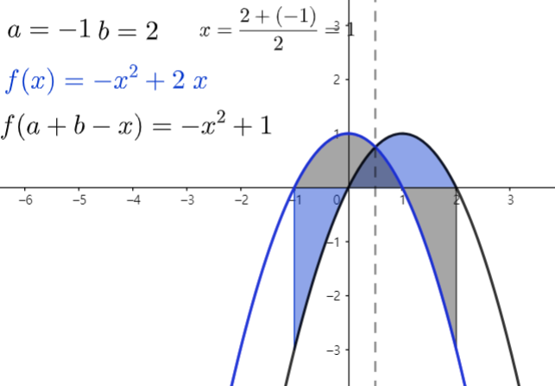



치환적분+적분 대칭성
$$\int_{a}^{b}{f\left(x\right)dx}=\int_{a}^{b}{f\left(a+b−x\right)dx}$$
=t 치환
y축대칭
$$f\left(x\right) f\left(−x\right)$$
$$\int_{−a}^{a}{f\left(x\right)dx}=\int_{−a}^{a}{f\left(−x\right)dx}$$
x=1대칭
$$f\left(x\right) f\left(2−x\right)$$
$$\int_{a}^{a}{f\left(x\right)dx}=\int_{2−a}^{a}{f\left(2−x\right)dx}$$
https://www.geogebra.org/classic/tvzgwvbc

Slide 3

치환적분+적분 대칭성
=t 치환
$$\int_{a}^{b}{f\left(x\right)dx}=\int_{a}^{b}{f\left(a+b−x\right)dx}$$
y축대칭
$$f\left(x\right) f\left(−x\right)$$
$$\int_{−a}^{a}{f\left(x\right)dx}=\int_{−a}^{a}{f\left(−x\right)dx}$$
x=1대칭
$$f\left(x\right) f\left(2−x\right)$$
$$\int_{a}^{a}{f\left(x\right)dx}=\int_{2−a}^{a}{f\left(2−x\right)dx}$$
https://www.geogebra.org/classic/tvzgwvbc

Slide 4
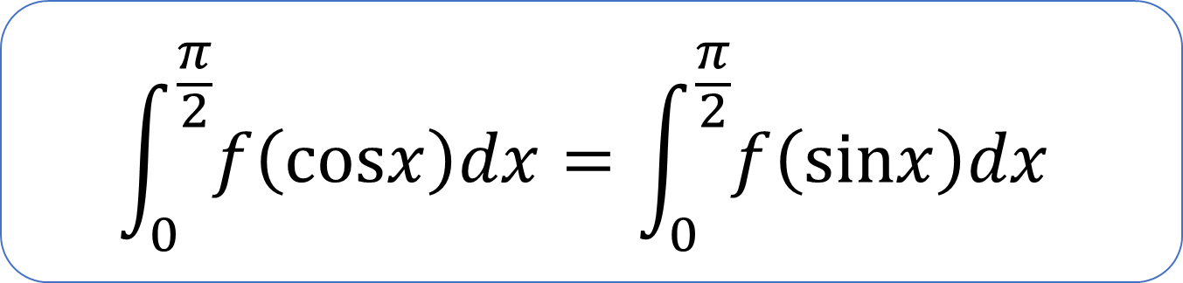

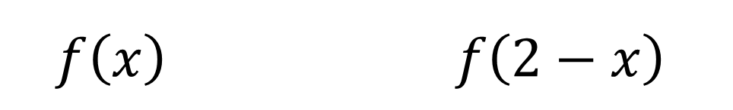
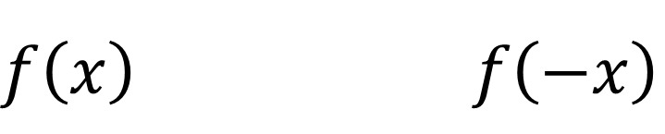
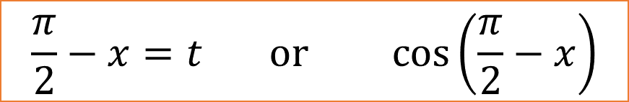
치환적분+적분 대칭성
=t 치환
$$\int_{a}^{b}{f\left(x\right)dx}=\int_{a}^{b}{f\left(a+b−x\right)dx}$$
y축대칭
$$f\left(x\right) f\left(−x\right)$$
$$\int_{−a}^{a}{f\left(x\right)dx}=\int_{−a}^{a}{f\left(−x\right)dx}$$
x=1대칭
$$f\left(x\right) f\left(2−x\right)$$
$$\frac{π}{2}−x=t or cos\left(\frac{π}{2}−x\right)$$
$$\int_{0}^{\frac{π}{2}}{f\left(cosx\right)dx}=\int_{0}^{\frac{π}{2}}{f\left(sinx\right)dx}$$
$$\int_{a}^{a}{f\left(x\right)dx}=\int_{2−a}^{a}{f\left(2−x\right)dx}$$
https://www.geogebra.org/classic/tvzgwvbc

Slide 5
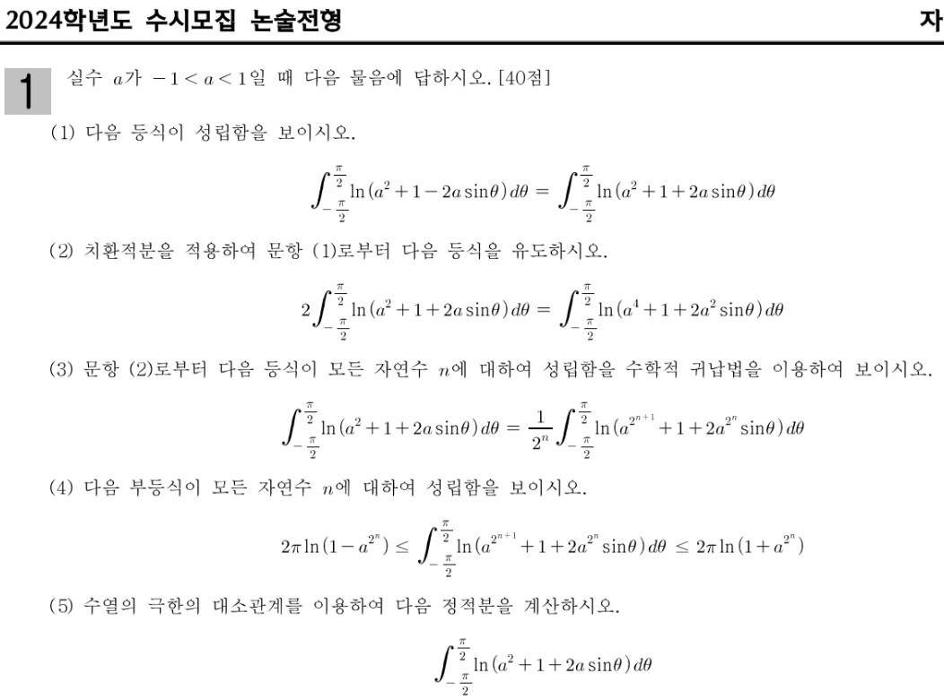
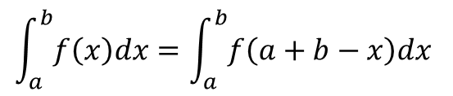
치환적분+대칭성
t 치환
$$\int_{a}^{b}{f\left(x\right)dx}=\int_{a}^{b}{f\left(a+b−x\right)dx}$$
25학년도 이화 자연1,2

Slide 6
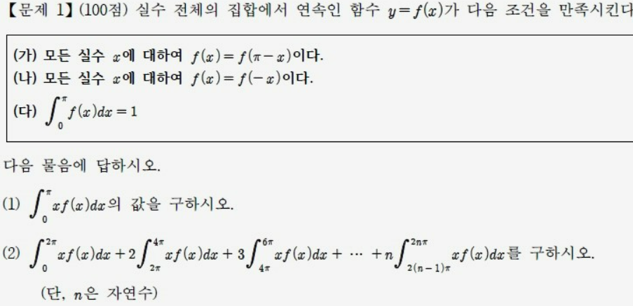
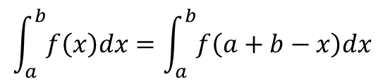
치환적분+적분 대칭성
t 치환
$$\int_{a}^{b}{f\left(x\right)dx}=\int_{a}^{b}{f\left(a+b−x\right)dx}$$
18학년도 울산대 의예
Notes:
https://blog.naver.com/yh6613/221395256590?trackingCode=blog_bloghome_searchlist 울산대 의예
https://blog.naver.com/yh6613/223341227622?trackingCode=blog_bloghome_searchlist 아주대
https://blog.naver.com/yh6613/223367181060?trackingCode=blog_bloghome_searchlist 광운대

Slide 7
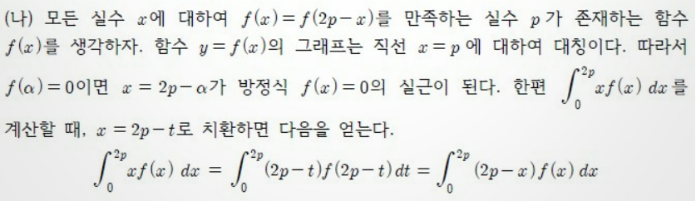
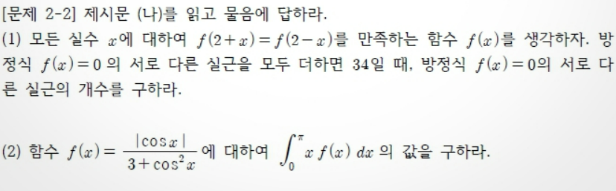
치환적분+적분 대칭성
t 치환
$$\int_{a}^{b}{f\left(x\right)dx}=\int_{a}^{b}{f\left(a+b−x\right)dx}$$
18학년도 울산대 의예
23학년도 아주대 오전
Notes:
https://blog.naver.com/yh6613/221395256590?trackingCode=blog_bloghome_searchlist 울산대 의예
https://blog.naver.com/yh6613/223341227622?trackingCode=blog_bloghome_searchlist 아주대
https://blog.naver.com/yh6613/223367181060?trackingCode=blog_bloghome_searchlist 광운대

Slide 8
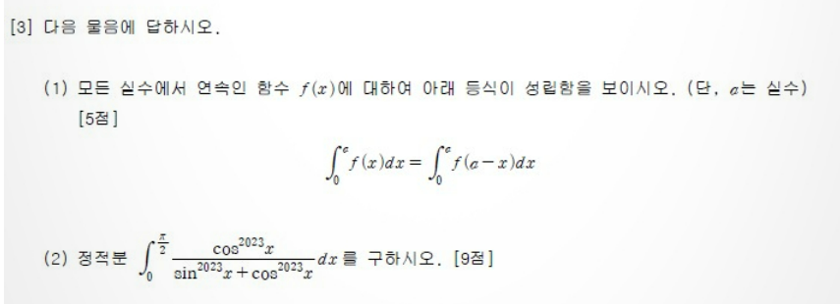
치환적분+적분 대칭성
t 치환
$$\int_{a}^{b}{f\left(x\right)dx}=\int_{a}^{b}{f\left(a+b−x\right)dx}$$
23학년도 광운대 오전
18학년도 울산대 의예
23학년도 아주대 오전
Notes:
https://blog.naver.com/yh6613/221395256590?trackingCode=blog_bloghome_searchlist 울산대 의예
https://blog.naver.com/yh6613/223341227622?trackingCode=blog_bloghome_searchlist 아주대
https://blog.naver.com/yh6613/223367181060?trackingCode=blog_bloghome_searchlist 광운대

Slide 9
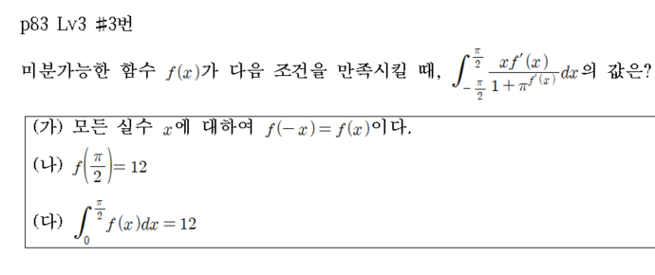
5

Slide 10
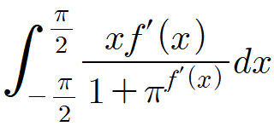
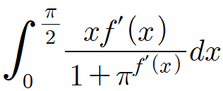
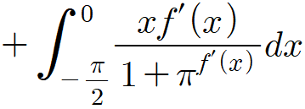

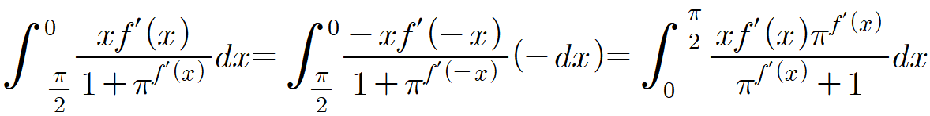
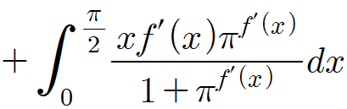
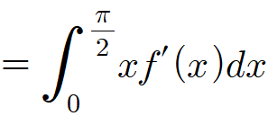
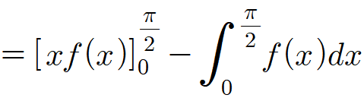

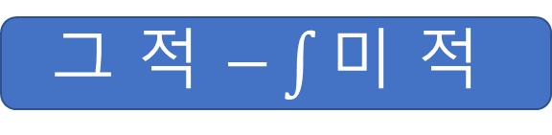
x=-t
치환
그 적 $−\int{\text{미 적 }}$

Slide 11

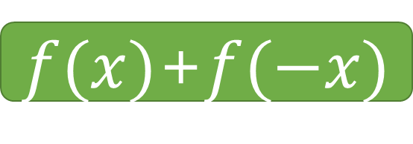


$$임의f(x)$$
$$a_{0}+a_{1}x+a_{2}x^{2}+a_{3}x^{3}+⋯+a_{n}x^{n}$$
$$f(−x)$$
$$a_{0}−a_{1}x+a_{2}x^{2}−a_{3}x^{3}+⋯+a_{n}x^{n}$$
수함우
우함수
$f(x)$+$f(−x)$
$$2a_{0}+a_{2}x^{2}+a_{4}x^{4}+⋯+a_{2n}x^{2n}$$
$$f(x)−f(−x)$$
$$2a_{1}x^{1}+2a_{3}x^{3}+{2a}_{5}x^{5}+⋯+a_{n}x^{ㅎ}$$
기함수
기함수
5

Slide 12
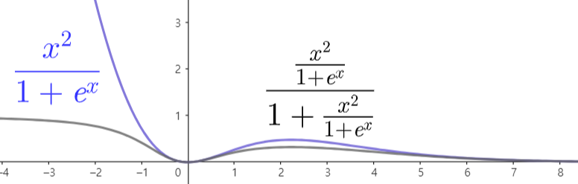
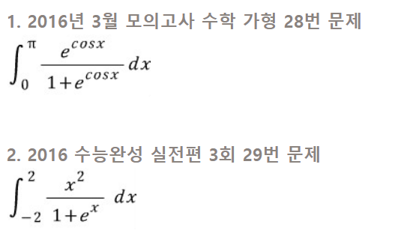
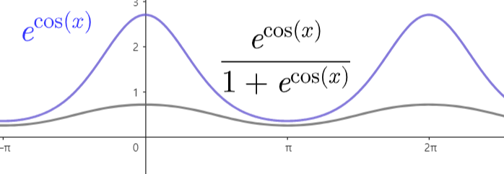
치환적분+적분 대칭성
https://www.geogebra.org/calculator/rbwfqsjt
t 치환
$$\int_{a}^{b}{f\left(x\right)dx}=\int_{a}^{b}{f\left(a+b−x\right)dx}$$
1
2

